Slide 1
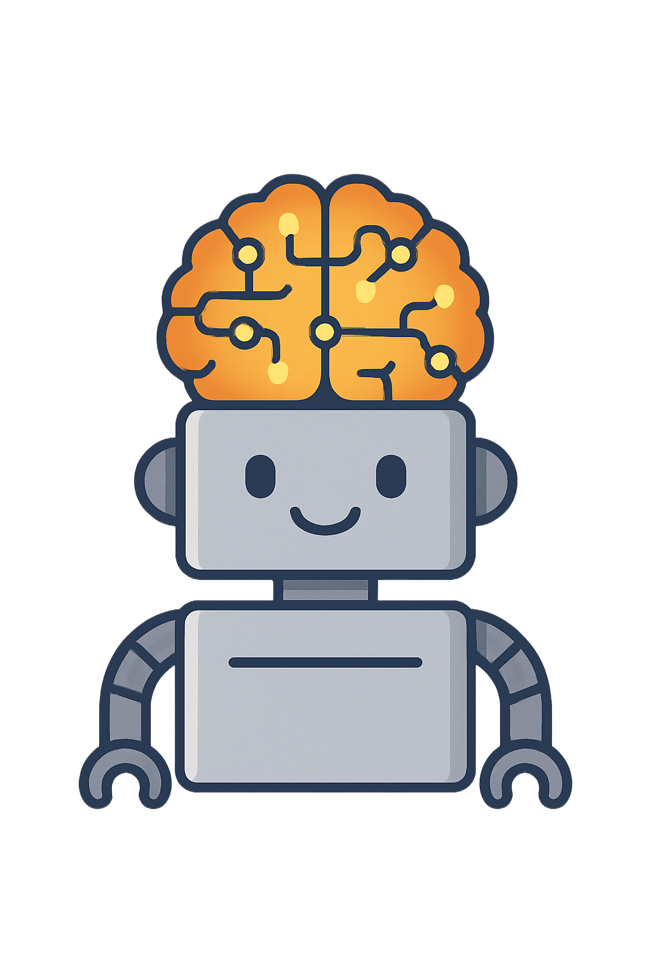
What Is Deep Learning?
Deep learning helps computers learn from experience, just like people do. Instead of a human brain, it uses layers of digital “neurons” that work together to make guesses and improve over time. Each neuron has small settings that help it decide what’s important — these are called weights and biases.

Slide 2
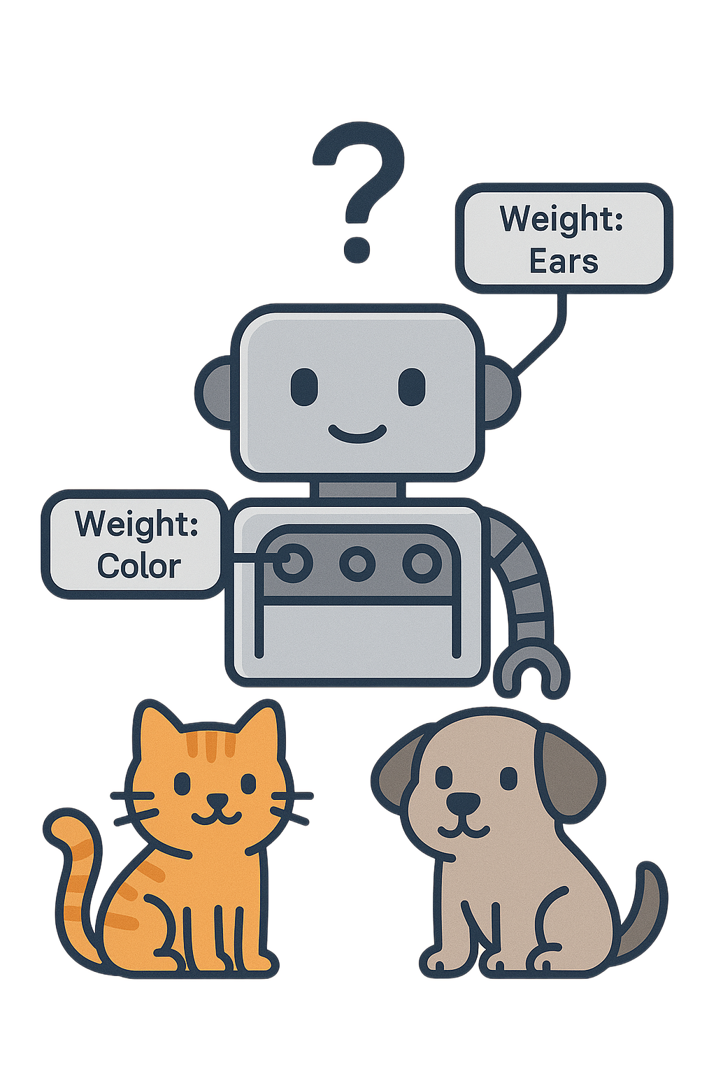
Meet Robo, the Learning Robot
Robo wants to learn how to tell cats and dogs apart. At first, Robo just guesses. But every time Robo is wrong, it tweaks its dials — its weights and biases — to get a little closer to the right answer next time.
The weights control how much attention Robo gives to different clues, like ear shape or fur color. The bias acts like a balance knob that helps Robo make a final choice when the clues are close.

Slide 3
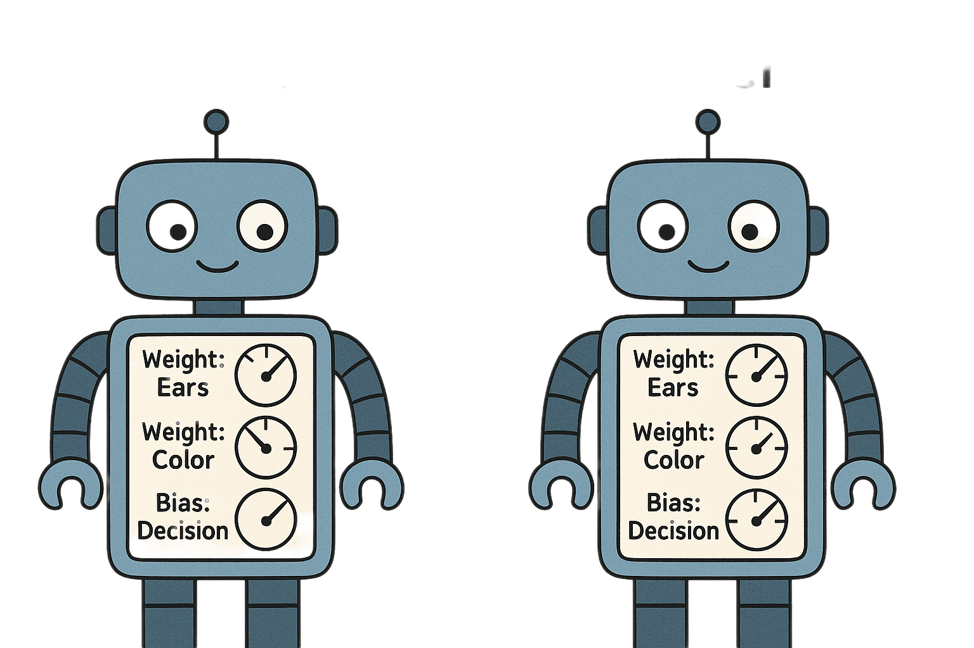
How Robo Learns Over Time
Each time Robo makes a mistake, it adjusts its dials just a bit. This process is repeated thousands of times, helping it learn patterns and make better guesses. Over time, Robo can spot cats, dogs, or even other animals with impressive accuracy.

Slide 4
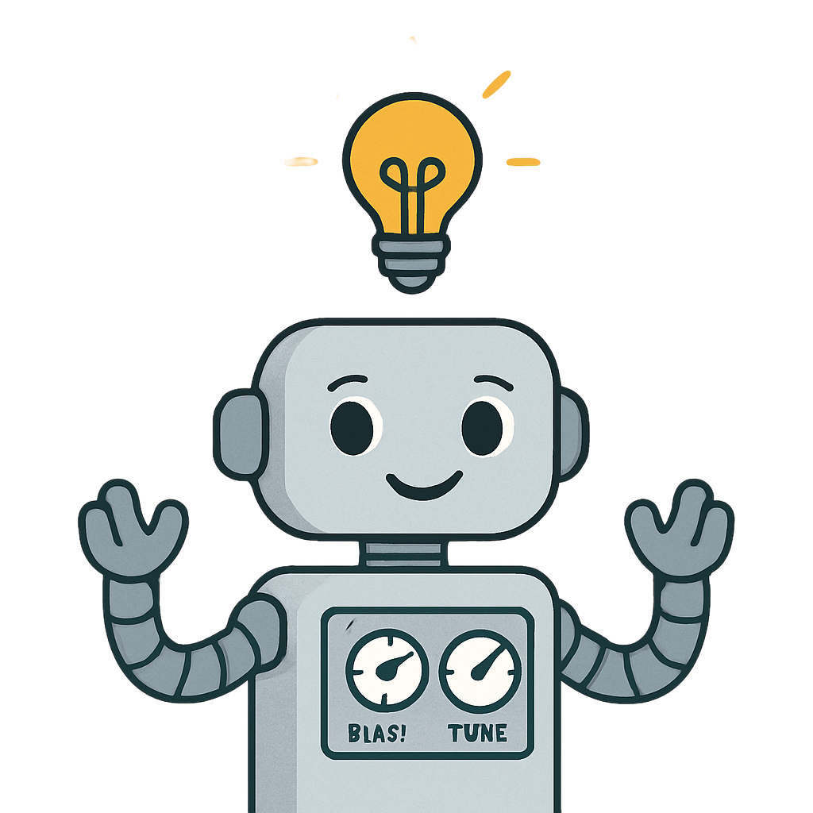
Reflections
I learned that weights and bias are the small adjustments that make deep learning possible. They let computers improve without needing new rules every time. Just like people, they get better through practice and feedback — one small correction at a time.

Slide 5
References
TensorFlow Playground (https://playground.tensorflow.org)
“Weights and Bias Explained Simply,” Towards Data Science (2023)

